Slide 1
Chapter 8
International Business: Opportunities and Challenges in a Flattening World
International Expansion and Global Market Opportunity Assessment
Mahmoud S. Monsef PhD

Slide 2
What’s in It for Me?
What are the inputs into global strategic move choices?
What are the components of PESTEL analysis and the factors that favor globalization?
What are the traditional entry modes for international expansion?
How can you use the CAGE model of market assessment?
What is the importance of and inputs into scenario analysis?

Slide 3
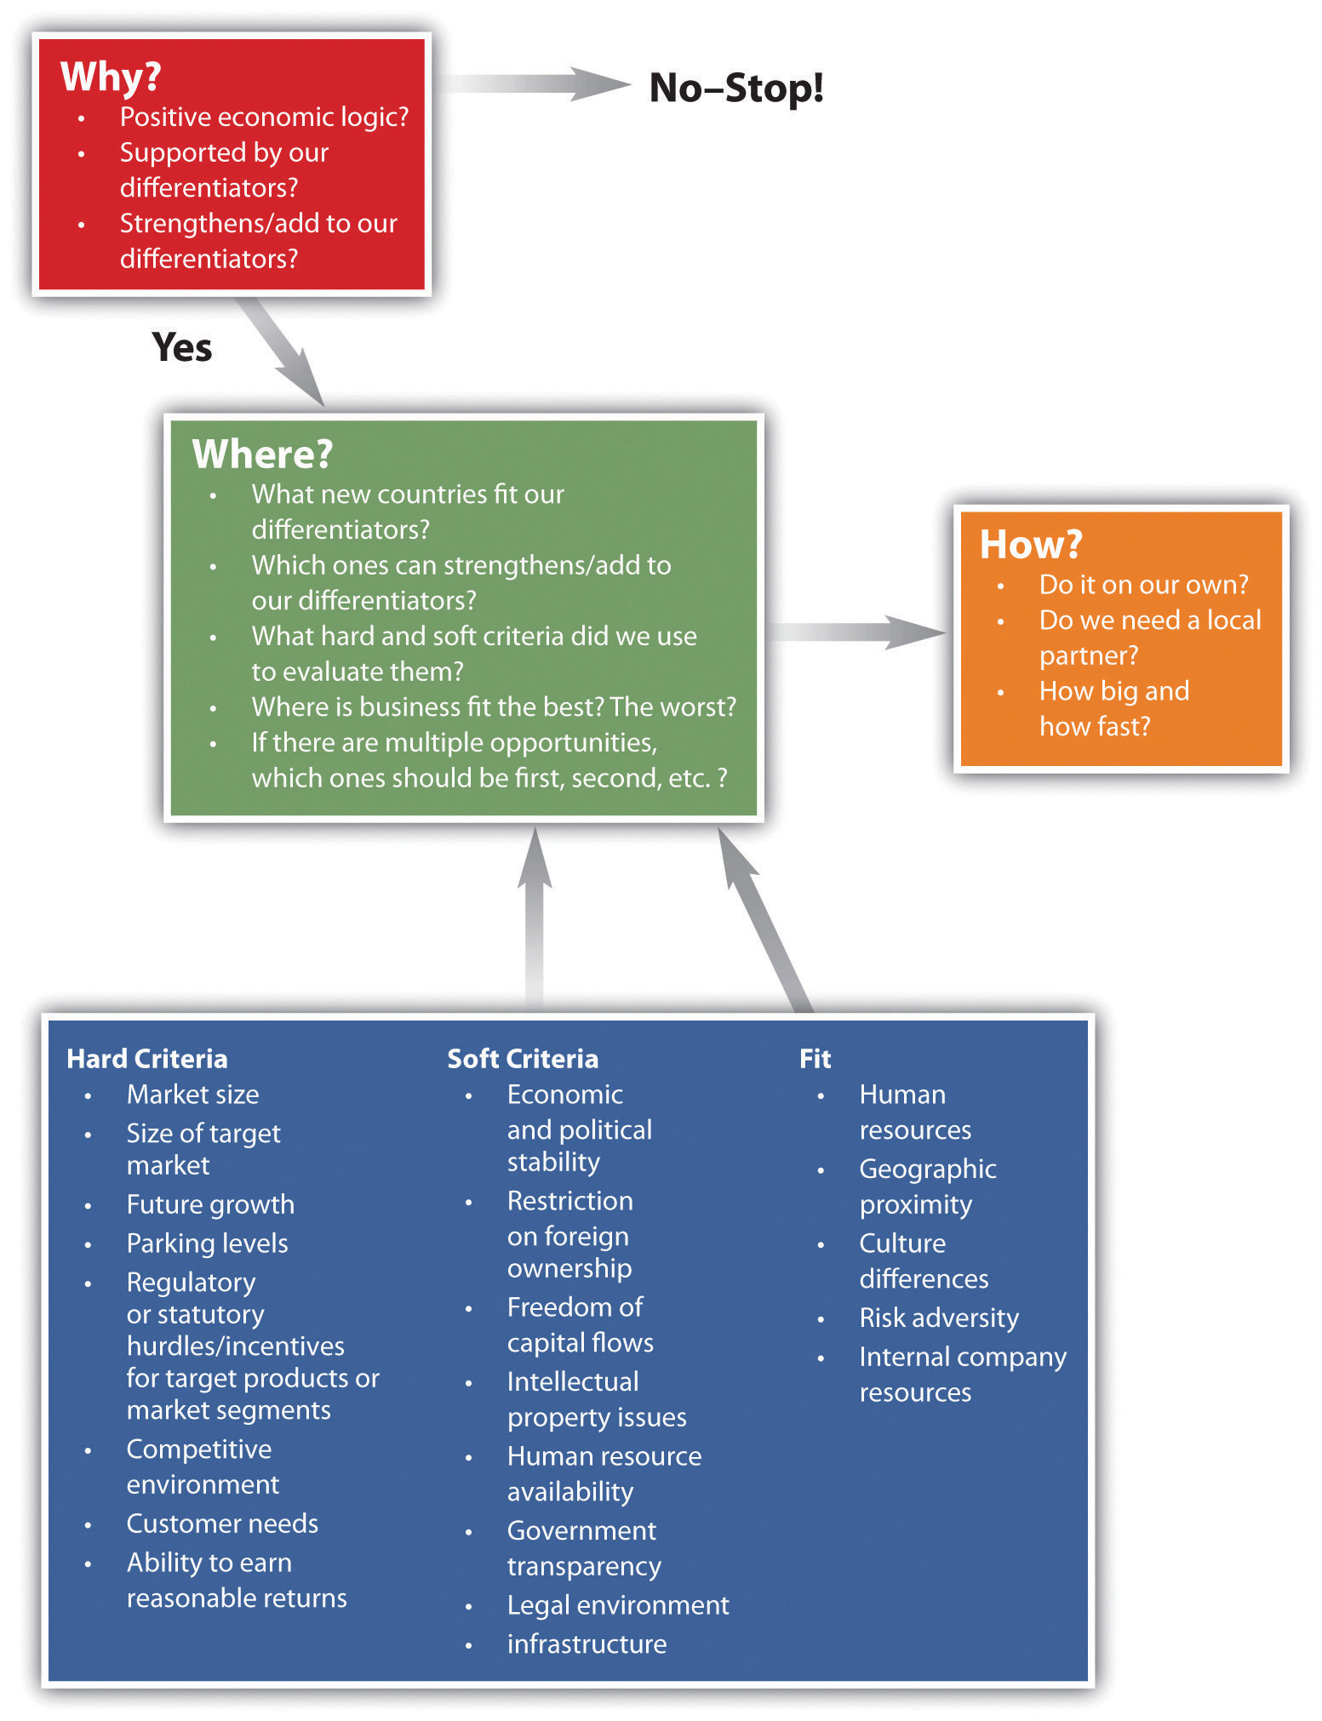

Slide 4
Rationale for International Expansion
Companies embark on an expansion strategy for one or more of the following reasons:
To improve the cost-effectiveness of their operations
To expand into new markets for new customers
To follow global customers

Slide 5
Planning for international expansion
Planning for international expansion involves doing a thorough due diligence on the potential markets into which the country is considering expanding.
This includes understanding the regional differences within markets, the needs of local customers, and the firm’s own capabilities in relation to the dynamics of the industry.

Slide 6
Common mistakes
Common mistakes that firms make when entering a new market include not doing thorough research prior to entry,
not understanding the competition,
and not offering a truly targeted value proposition for buyers in the new market.

Slide 7
Steps in the PESTEL analysis
There are three steps in the PESTEL analysis.
First, consider the relevance of each of the PESTEL factors to your context.
Next, identify and categorize the information that applies to these factors.
Finally, analyze the data and draw conclusions.

Slide 8
Common mistakes
Common mistakes in this analysis include stopping at the second step or
assuming that the initial analysis and conclusions are correct without testing the assumptions and investigating alternative scenarios.

Slide 9
PESTEL analysis
A PESTEL analysis examines a target market’s political, economic, social, technological, environmental, and legal dimensions in terms of both its current state and possible trends.
An understanding of the dimensions of PESTEL helps you better grasp the dimensions on which a target market or industry may be more global or local.

Slide 10
PESTEL analysis
Importing is a stealth form of international entry, because the factors that favor globalization can also lead to a higher level of imports, and
inputs can be sourced from anywhere they have either the lowest cost, highest quality, or some combination of these characteristics.
Notes:
So it is necessary to PESTEL

Slide 11
Political
  How stable is the political environment in the prospective country?
  What are the local taxation policies? How do these affect your business?
  Is the government involved in trading agreements, such as the European Union (EU), the North American Free Trade Agreement (NAFTA), or the Association of Southeast Asian Nations (ASEAN)?
  What are the country’s foreign-trade regulations?
  What are the country’s social-welfare policies?

Slide 12
Economic
  What are the current and forecast interest rates?
  What is the current level of inflation in the prospective country? What is it forecast to be? How does this affect the possible growth of your market?
  What are local employment levels per capita, and how are they changing?
  What are the long-term prospects for the country’s economy, gross domestic product (GDP) per capita, and other economic factors?
  What are the current exchange rates between critical markets, and how will they affect production and distribution of your goods?

Slide 13
Socio cultural
  What are the local lifestyle trends?
  What are the country’s current demographics, and how are they changing?
  What is the level and distribution of education and income?
  What are the dominant local religions, and what influence do they have on consumer attitudes and opinions?
  What is the level of consumerism, and what are the popular attitudes toward it?
  What legislation could affect corporate social policies (e.g., domestic-partner benefits or maternity and paternity leave)?
What are the attitudes toward work and leisure

Slide 14
Technological
  To what level do the local government and industry fund research, and are those levels changing?
  What is the local government’s and industry’s level of interest and focus on technology?
  How mature is the technology?
  What is the status of intellectual property issues in the local environment?

Slide 15
Environmental
  What are the local environmental issues?
  Are there any pending ecological or environmental issues relevant to your industry?
  How do the activities of international activist groups (e.g., Greenpeace, Earth First!, and People for the Ethical Treatment of Animals [PETA]) affect your business?
  Are there environmental-protection laws?
  What are the regulations regarding waste disposal and energy consumption?

Slide 16
Legal
  What are the local government’s regulations regarding monopolies and private property?
  Does intellectual property have legal protections?
  Are there relevant consumer laws?
  What is the status of employment, health and safety, and product safety laws?

Slide 17
International-Expansion Entry Modes
The five most common modes of international-market entry are exporting, licensing, partnering, acquisition, and Greenfield venturing.
Each of these entry vehicles has its own particular set of advantages and disadvantages.

Slide 18
export
By choosing to export, a company can avoid the substantial costs of establishing its own operations in the new country,
but it must find a way to market and distribute its goods in that country

Slide 19
International-Expansion Entry Modes
Type of Entry | Advantages | Disadvantages
Exporting | Fast entry, low risk | Low control, low local knowledge, potential negative environmental impact of transportation

Slide 20
license or franchise
By choosing to license or franchise its offerings, a firm lowers its financial risks but
also gives up control over the manufacturing and marketing of its products in the new country.

Slide 21
International-Expansion Entry Modes
Type of Entry | Advantages | Disadvantages
Licensing and Franchising | Fast entry, low cost, low risk | Less control, licensee may become a competitor, legal and regulatory environment (IP and contract law) must be sound

Slide 22
Partnerships and strategic alliances
Partnerships and strategic alliances reduce the amount of investment that a company needs to make because the costs are shared with the partner.
Partnerships are also helpful to make the new entrant appear to be more local because it enters the market with a local partner.
But the overall costs of partnerships and alliances are higher than exporting, licensing, or franchising, and there is a potential for integration problems between the corporate cultures of the partners.

Slide 23
International-Expansion Entry Modes
Type of Entry | Advantages | Disadvantages
Partnering and Strategic Alliance | Shared costs reduce investment needed, reduced risk, seen as local entity | Higher cost than exporting, licensing, or franchising; integration problems between two corporate cultures

Slide 24
Acquisitions
Acquisitions enable fast entry and less risk from the standpoint that the operations are established and known,
but they can be expensive and may result in integration issues of the acquired firm to the home office.

Slide 25
International-Expansion Entry Modes
Type of Entry | Advantages | Disadvantages
Acquisition | Fast entry; known, established operations | High cost, integration issues with home office

Slide 26
Greenfield ventures
The process of establishing of a new, wholly owned subsidiary (also called a Greenfield venture) is often complex and potentially costly,
but it affords the firm maximum control and has the most potential to provide above-average returns.

Slide 27
Greenfield ventures
The costs and risks are high given the costs of establishing a new business operation in a new country.
The firm may have to acquire the knowledge and expertise of the existing market by hiring either host-country nationals—possibly from competitive firms—or costly consultants.
An advantage is that the firm retains control of all its operations.

Slide 28
International-Expansion Entry Modes
Type of Entry | Advantages | Disadvantages
Greenfield Venture (Launch of a new, wholly owned subsidiary) | Gain local market knowledge; can be seen as insider who employs locals; maximum control | High cost, high risk due to unknowns, slow entry due to setup time

Slide 29
entry mode
Which entry mode a firm chooses also depends on the firm’s size, financial strength, and the economic and regulatory conditions of the target country.
A small firm will likely begin with an export strategy.
Large firms or firms with deep pockets might begin with an acquisition to gain quick access or to achieve economies of scale.

Slide 30
entry mode
If the target country has sound rule of law and strong adherence to business contracts,
licensing, franchising, or partnerships may be middle-of-the-road approaches
that are neither riskier nor more expensive than the other options.

Slide 31
The CAGE Framework
The CAGE Framework is an international strategy guru who offer businesses a way to evaluate countries in terms of the “distance” between them.
distance is defined broadly to, include not only the physical geographic distance between countries but also the cultural, administrative (currencies, trade agreements), and economic differences between them.

Slide 32
The CAGE Framework
the CAGE (cultural, administrative, geographic, and economic) framework offers a broader view of distance and provides another way of thinking about location and the opportunities and concomitant risks associated with global arbitrage

Slide 33
CAGE analysis
CAGE analysis asks you to compare a possible target market to a company’s home market on the dimensions of culture, administration, geography, and economy.
CAGE analysis yields insights in the key differences between home and target markets and allows companies to assess the desirability of that market.

Slide 34
CAGE analysis
CAGE analysis can help you identify institutional voids, which might otherwise frustrate internationalization efforts.
Institutional differences are important to the extent that the absence of specialized intermediaries can raise transaction costs just as their presence can reduce them

Slide 35
The CAGE Framework
Attributes Creating Distance
Cultural Distance | Administrative Distance | Geographic Distance | Economic Distance
Different languages | Absence of colonial ties | Physical remoteness | Differences in consumer incomes
Different ethnicities; lack of connective ethnic or social networks | Absence of shared monetary or political association | Lack of a common border | Differences in costs and quality of the following: • Natural resources • Financial resources • Human resources • Infrastructure • Intermediate inputs • Information or knowledge

Slide 36
The CAGE Framework
Attributes Creating Distance
Cultural Distance | Administrative Distance | Geographic Distance | Economic Distance
Different religions | Political hostility | Lack of sea or river access
Different social norms | Government policies | Size of country
 | Institutional weakness | Weak transportation or communication links
 |  | Differences in climates

Slide 37
The CAGE Framework
Industries or Products Affected by Distance
Cultural Distance | Administrative Distance | Geographic Distance | Economic Distance
Products have high-linguistic content (TV). | Government involvement is high in industries that are • producers of staple goods (electricity), • producers of other “entitlements” (drugs), • large employers (farming), • large suppliers to government (mass transportation), • national champions (aerospace), • vital to national security (telecommunications), • exploiters of natural resources (oil, mining), and • subject to high-sunk costs (infrastructure). | Products have a low value-of-weight or bulk ratio (cement). | Nature of demand varies with income level (cars).
Products affect cultural or national identity of consumers (foods). |  | Products are fragile or perishable (glass or fruit). | Economies of standardization or scale are important (mobile phones).

Slide 38
some facts that will help understand important of country branding
To attract investment, tourists and businesses countries spend each year:
United States – about $ 1.4 billion;
Britain and Germany for about $ 1.2 billion;
France – about $ 3.1 billion;
Saudi Arabia – $ 6 billion

Slide 39
Brands of countries are more expensive than budgets.
Thus, according to Simon Anholt,
the brand "America" is worth $ 18 trillion, which represents about 152% of U.S. GDP,
and the brand "The UK is estimated at $ 3.5 trillion or 163% of GDP

Slide 40
Overall ranking of brands (Anholt-GfK Roper Nation Brands Index), the first 10 of the 50 countries in 2009: 1. U.S. 2. France 3. Germany 4. United Kingdom 5. Japan 6. Italy 7. Canada 8. Switzerland 9. Australia 10. Spain
according to Simon Anholt expert in marketing national brand is determined by the characteristics of the countries by six factors:

Slide 41
Exports – determines the public's image of products and services from each country and the extent to which consumers proactively seek or avoid products from each country-of-origin.

Slide 42
Governance – measures public opinion regarding the level of national government competency and fairness and describes individuals' beliefs about each country's government, as well as its perceived commitment to global issues such as democracy, justice, poverty and the environment.

Slide 43
Culture and Heritage – reveals global perceptions of each nation's heritage and appreciation for its contemporary culture, including film, music, art, sport and literature.

Slide 44
People – measures the population's reputation for competence, education, openness and friendliness and other qualities, as well as perceived levels of potential hostility and discrimination.

Slide 45
Tourism – captures the level of interest in visiting a country and the draw of natural and man-made tourist attractions.
Investment and Immigration – determines the power to attract people to live, work or study in each country and reveals how people perceive a country's economic and social situation

